Slide 1
ECOSYSTEM

Slide 2
INTRODUCTION
ECOLOGY involves the study of interrelationships of organisms with another and with environment.
POPULATION: The group of interbreeding individuals of the same species residing in the same geographical area.
BIOTIC COMMUNITY: Population of different species found in the same geographical area.
DEFINITION
Ecosystem is an integrated system resulting from interaction of living and non living factors of the environment.
Term ecosystem first coined by A.G. Tansley (1935).
Ecosystem was defined in its presently accepted form by Eugene Odum as,” the basic functional unit of ecology in which both biotic community and abiotic environment influence each other.

Slide 3
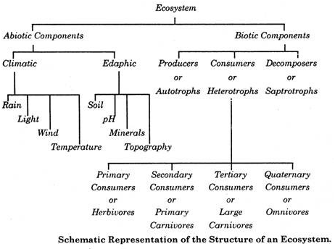
STRUCTURE OF AN ECOSYSTEM
Fig. 1 Structure of Ecosystem

Slide 4
ENERY FLOW TROPHIC ORGANISATION
Energy flow is the flow of energy through livings within an ecosystem.
All living organisms can be organized into producers and consumers can further be organized into food chain.
Each of the levels within the food chain is a trophic level.

Slide 5
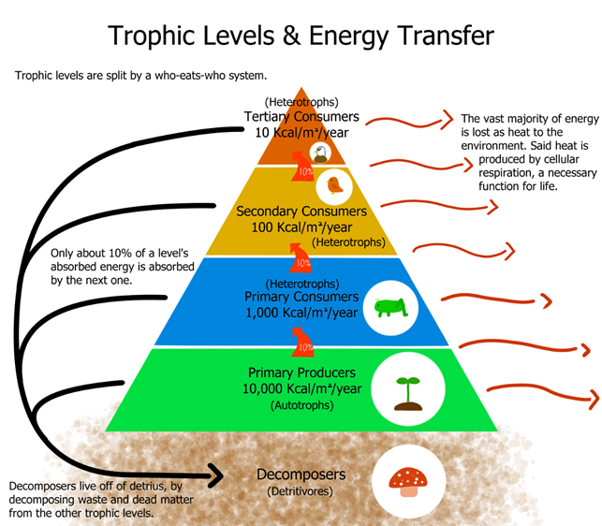
Fig.2 Energy flow trophic organization

Slide 6
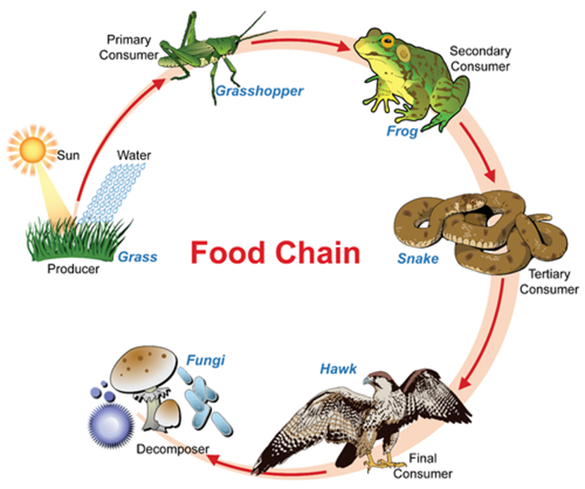
FOOD CHAIN
DEFINITION: It is a series of group of organisms called trophic level in which there is repeated eating and eaten by so as to transfer the food energy.
Types of food chains-
Grazing food chains
Detritus food chains
Fig.3 Diagram of food chain

Slide 7
TYPE OF ECOSYSTEM | PRODUCERS | HERBIVORES | PRIMARY CARNIVORES | SECONDARY CARNIVORES | TERTIARY CARNIVORES
GRASSLAND ECOSYSTEM | GRASSES GRASSES GRASSES | INSECTS RATS AND MICE RABBIT | FROGS SNAKES FOX | SNAKES PREDATORS BIRDS WOLF | PREDATORY BIRDS LION
POND SYSTEM | PHYTOPLANKTONS | ZOOPLANKTONS | SMALL FISHES | LARGE FISHES | PREDATORY BIRDS
FOREST ECOSYSTEM | TRESS | PHYTOPHAGOUS INSECTS,HERBIVORE MAMMALS | LIZARD, BIRDS, FOXES | LIONS, TIGERS ETC.
TABLE OF GRAZING TYPE FOOD CHAINS AND DETRITUS TYPE FOOD CHAIN
DETRITUS | DETRITIVORES | DETRITUS CONSUMERS | SMALL CARNIVORES | LARGE CARNICORES
MANGROVE FALLEN LEAVES AND DEAD ORGANIC MATTER | FUNGI, BACTERIA AND PROTOZOANS | INSECT LARVE, CERTAIN CRUSTACEANS, MOLLUSCS AND FISHES | MINNOWS, SMALL GAME FISH ETC. | LARGE FISH, FISH EATING BIRDS.

Slide 8
FOOD WEB OR FOOD CYCLE
It is a network of food chains which become interconnected at various trophic levels so as to form a number of feeding connections amongst different organisms of a biotic community.
Types
Terristrial food web
Aquatic food web

Slide 9
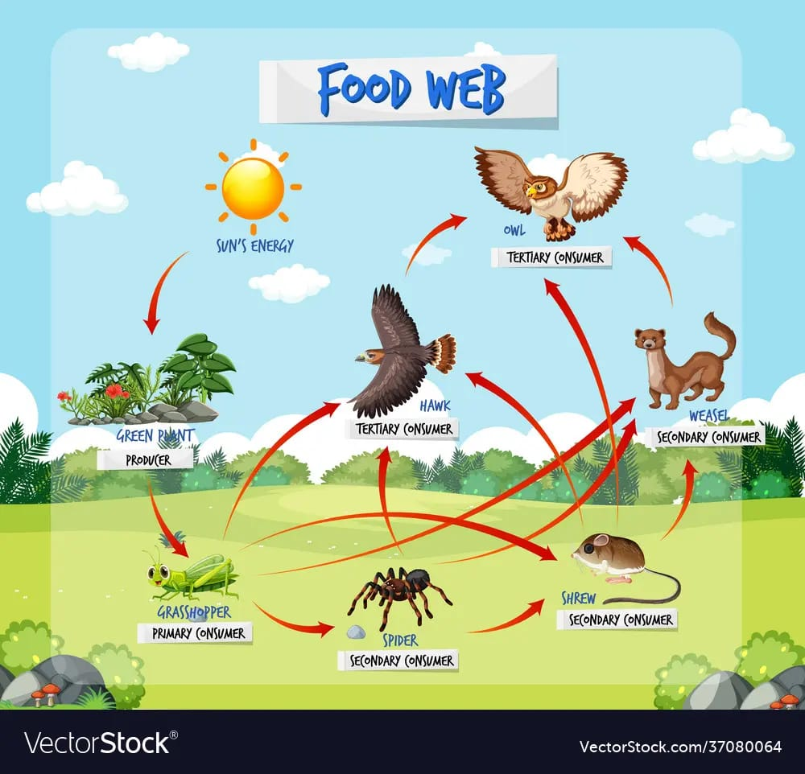
fig.4 Food web cycle

Slide 10
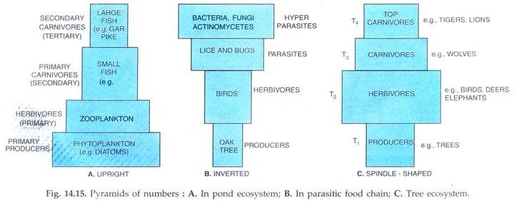
ECOLOGICAL PYRAMIDS
An ecological pyramid is a graphical representation of an ecological parameter, like number or biomass or accumulated energy, at diiferent trophic level in a food chain in an ecosystem.
Types of ecological pyramids
Pyramid of number- it is a graphic representation showing the arrangement of number of individuals( population size) of different trophic level in a food chain per unit area at any time in an ecosystem.
Fig.5 diagram of pyramid of number in pond, parasite and tree system

Slide 11
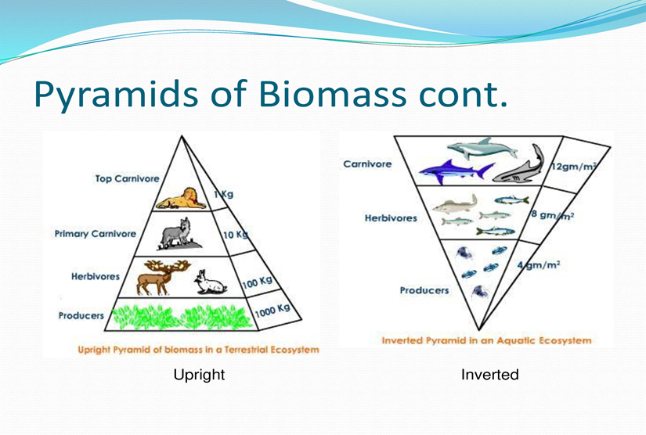
b) Pyramid of Biomass- it is a graphic representation of biomass present per unit area of different trophc levels (standing crop).
Fig.6 Pyramid of Biomass

Slide 12
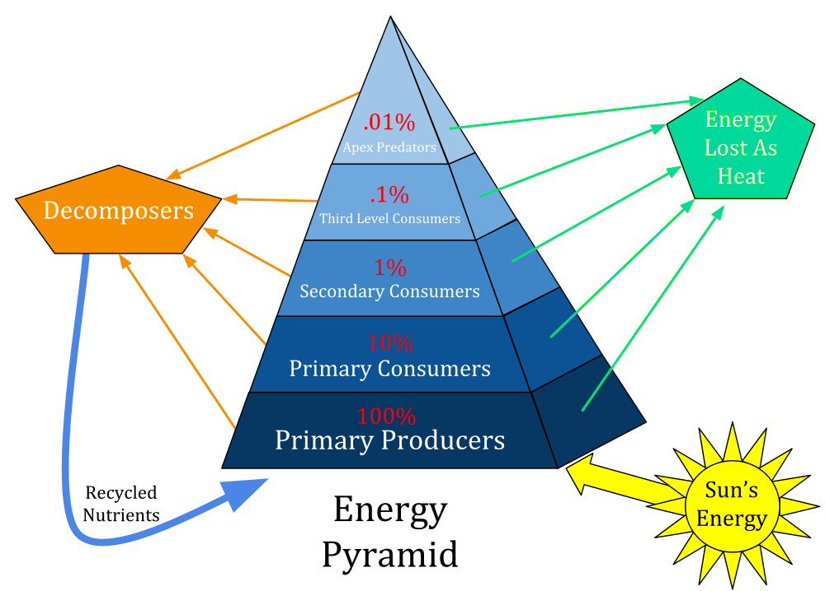
c) Pyramid of energy- it is a graphic representation of amount of energy trapped per unit time and area in different trophic level of a food chain.
Fig. 7 Pyramid of Energy

Slide 13
BIOGEOCHEMICAL CYCLES
Biogeochemical cycles are the cyclic pathways through which chemical elements move from the environment to organism and back to the environment.
These are also called nutrients cycles.
On the basis of reservoir there are two type of biogeochemical cycles
Gaseous cycles-e.g. Carbon, hydrogen, oxygen & nitrogen cycles.In this case reservoir for elements in the atmosphere or hydrosphere.
Sedimentary cycle-e.g. Phosphorous, sulphur, potassium & calcium cycles. In the reservoir for the elements is in sediments of the earth. These are very slow in action.

Slide 14
COMMON BIOGEOCHEMICAL CYCLES:
NITROGEN CYCLE
The nitrogen cycle is the biogeochemical cycle by which nitrogen is converted into multiple chemical forms as it circulates among atmosphere, terristrial and marine ecosystem.
The conversion of nitrogen can be carried out through both biological and physical processes.
The nitrogen cycle has 5 stages:
Nitrogen fixation
Nitrification
Assimilation
Ammonification
Denitrification

Slide 15
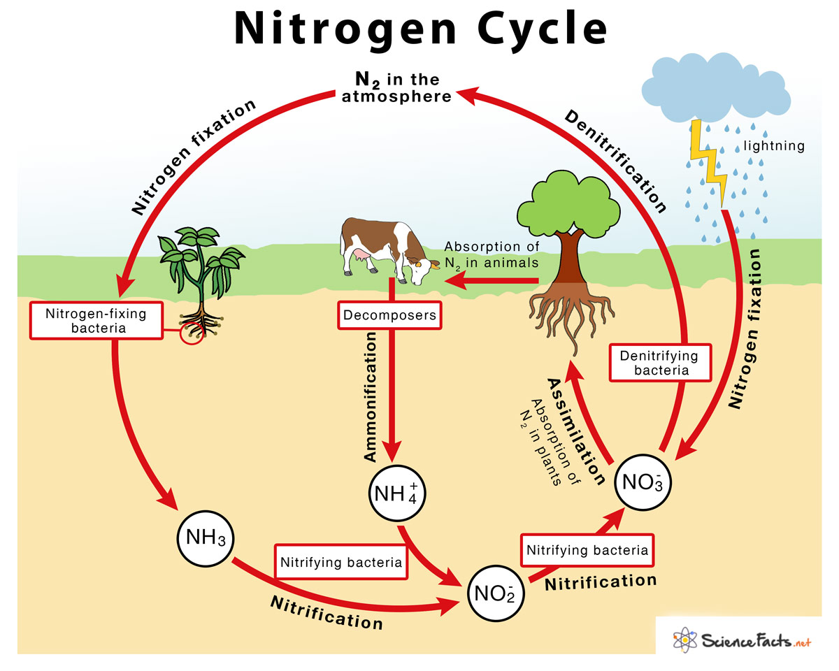
Fig. 8 Diagram of Nitrogen cycle

Slide 16
PHOSPHOROUS CYCLE
It is a biogeochemical process that involves the movement of phosphorous through the lithosphere, hydrosphere and biosphere.
Steps of phosphorous cycle:
Weathering
Absorption by plants
Absorption by animals
Return to the environment through decomposition

Slide 17
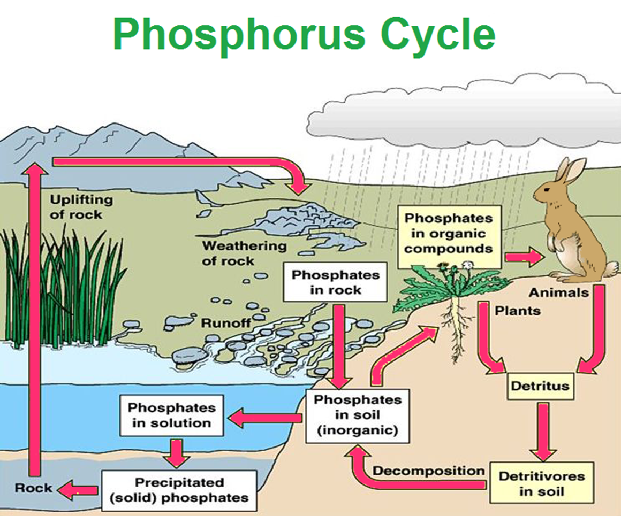
Fig.9 Diagram of Phosphorous cycle

